Slide 1
About the Fair Work Ombudsman (FWO)
Federal government agency
Provides free education and information about workplace rights and entitlements
Helps to resolve workplace issues
Has tailored tools and resources for international students
Notes:
The Fair Work Ombudsman is a government agency that provides workplace advice and assistance to individuals and organisations for free. It is impartial, and does not represent any party.
It makes sure that work rights are:
protected
understood, and
enforced.
In Australia, all workers have certain rights if they are working and they are protected by Australia’s workplace laws. These include a minimum wage and entitlements.
Workers have these rights regardless of the length of their stay in Australia or their visa type.

Slide 2
Types of employment
Full time
Part time
Casual
Notes:
In Australia, there are different types of employment types. The three most common types are: full time, part time and casual.
Full time and part time employment
Full time employees work 38 hours a week and receive paid annual leave, sick leave and notice of termination. Part time employees work regular hours but less than 38 hours per week. They get the same types of leave and termination entitlements as a full time employee but these are calculated based on the number of hours they work each week.
Casual employment and loading
Casual employees are not guaranteed work, they only work when the business wants them to. They do not receive paid leave or notice of termination entitlements either. They get paid higher than full time and part time employees to compensate for this.

Slide 3
National Minimum Wage – from 1 July 2017
Full time worker
Part time worker
Casual worker
$18.29
$22.86
(25% casual loading)
Notes:
In Australia, all workers are entitled to a minimum wage. Currently (as at 1 July 2017), the National Minimum Wage for full-time or part-time adult employees (21 years of age and over) is $18.29 per hour, and $22.86 per hour for casual employees.
It’s important to find out from your employer what type of worker you are, to make sure you receive the correct entitlements.
Full-time and part-time employees usually get regular and set hours of work, and they receive sick leave, annual leave and notice of termination.
Casuals get a higher rate of pay because they do not receive entitlements like sick leave, annual leave and notice of termination. This extra payment is known as a casual loading.
Rates of pay usually increase on the first of July each year.
If you are covered by an Award or Enterprise Agreement, your minimum wage could be higher than the National Minimum wage.
You can’t be paid less than the applicable minimum wage, even if you’ve agreed to it. To make sure you receive the correct pay for the hours you’ve worked, your employer must also provide you with a payslip within one working day of each pay day. A pay slip is a document that shows you how much you’ve received during a pay period, and if the employer has made any deductions, such as for tax.

Slide 4
Department of Home Affairs (DHA) and FWO
The DHA will not cancel a person’s temporary visa if they:
had an entitlement to work as part of their visa
believe they have been exploited at work
have reported their circumstances to the FWO
are actively assisting the FWO in an investigation
This applies as long as:
They commit to abiding by visa conditions in the future
There is no other basis for visa cancellation
Notes:
Sometimes, international students may be in a situation where they are underpaid and work beyond what they are allowed to, such as working more than 40 hours per fortnight during semester. They fear that reporting their issue to the Fair Work Ombudsman may result in them losing their visa.
This is not true. To encourage international students like you to approach the FWO for help, the Department of Home Affairs has agreed that it will not cancel a person’s temporary visa if they:
had an entitlement to work as part of their visa;
believe they have been exploited at work; and
have reported their circumstances to the Fair Work Ombudsman and are actively assisting them in an investigation
This applies as long as you commit to abiding by visa conditions in the future; and there is no other basis for visa cancellation (such as on national security, character, health or fraud grounds)

Slide 5
Getting help It’s OK to ask for information or help!
It’s against the law to be sacked for asking about pay or entitlements
It’s against the law to be sacked for contacting the Fair Work Ombudsman
Anonymous reporting tool
Notes:
What happens if you need help because you suspect something isn’t quite right? We know that many workers are worried about asking questions, or complaining about what’s happening at work. But it is OK to ask for information or for help and you can’t get into trouble for doing it.
It’s against the law if your boss sacks you, or reduce your shifts:
if you ask about your pay or other entitlements or
if you contact the Fair Work Ombudsman.
If you contact the Fair Work Ombudsman your information is kept confidential. They won’t contact your boss unless you want them to.
If you are not comfortable about giving them your personal details, you can also contact the Fair Work Ombudsman anonymously. On their website, you can lodge an anonymous report about an employer you believe is not following workplace laws.

Slide 6
Record My Hours App
Automatically record and store hours of work
Export data via email
Add rosters to calendar
Receive notifications about shifts
Back up information on iCloud or Dropbox
Available in 18 languages – the app will recognise language settings
No data stored centrally – you control how you share your information!
The app is free and can be downloaded at:
iTunes app store: http://apple.co/2nKKloL
Play store: http://bit.ly/2mUzMli
Notes:
We strongly encourage you to keep your own time records. It can make it easier to resolve disputes about pay and hours worked.
The FWO’s Record My Hours app is a free and easy way for employees to record and store the hours they work, plus other information about their employment.
Employees can retrieve this information instantly if an issue about their pay arises and be confident when discussing the issue with their employer.
Users can export the data via email to save it somewhere securely, share it with their employer or even with the FWO if they have a question about their entitlements.
The app uses the phone’s location services and ‘geofencing’ technology to let users set their workplace location and automatically record when they start and finish work, based on their location. However you can manually record if you don’t have mobile or Wi-Fi coverage
Other functionality includes the ability to:
add rosters to a calendar
receive notification reminders about upcoming shifts
take photos of information that belongs to you or you’re allowed access to, like your pay slips
back-up information collected to iCloud or Dropbox and recover it easily
record information about piecework arrangements – users can record information about the number of pieces achieved within a time period and use their smartphone’s location and mapping services to pinpoint any places of work.
The app is available in 18 languages and recognises a user’s language settings.
No data is stored centrally. You control how you share this information.
It’s also important to keep a note of:
Business name and Australian Business Number (ABN)
If you’re paid by cash, write down the amount, date and person who paid you

Slide 7
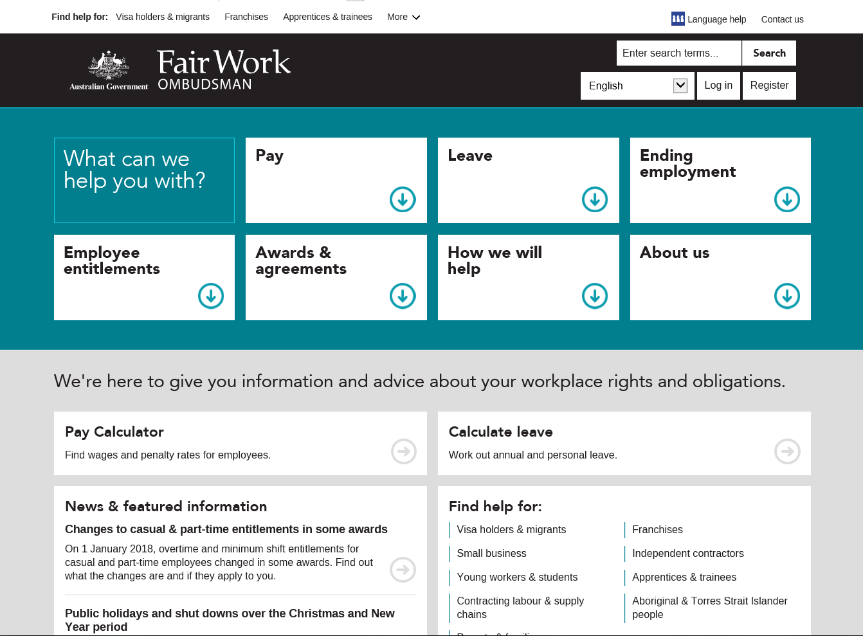
www.fairwork.gov.au
Notes:
The Fair Work Ombudsman has a website and the address is www.fairwork.gov.au.
Within the website is information on a range of topics including pay, awards and other entitlements, grouped together by topic.
There is other useful information available such as fact sheets, videos and courses to help you understand your rights.
Mention language plug in when the wording is made available.

Slide 8
Tools and resources for international students
Dedicated webpage for international students including a case study www.fairwork.gov.au/internationalstudents
Pay and Conditions Tool (PACT) www.fairwork.gov.au/PACT
In-language page www.fairwork.gov.au/languages
Record My Hours App www.fairwork.gov.au/app
The Anonymous Report tool www.fairwork.gov.au/tipoff
Open letter to international students www.fairwork.gov.au/openletterstudents
Information for young workers including workplace myths and tips
www.fairwork.gov.au/youngworkers
Notes:
Here are a few online tools and resources which international students can use to learn about their workplace rights or lodge an enquiry with them.
There is tailored information for international students at www.fairwork.gov.au/internationalstudents where you can find out more about your pay and conditions, or how to get help with workplace issues. You will also find Jessica’s Story – a case study about an international student who made a request for assistance to the Fair Work Ombudsman regarding her entitlements, which we encourage you to read.
The Pay and Conditions Tool can be used to work out an your minimum rates of pay, and other entitlements such as paid leave, termination and redundancy pay.
There is professionally translated information in 30 languages other than English available on our in-language page to help students understand their rights. Some of the languages include Chinese, Korean, Vietnamese and Arabic. You can also change the language setting on the page into one of 40 languages.
The Fair Work Ombudsman strongly encourages workers to keep their own work records. The Record My Hours app makes it quick and easy for employees to record and store the hours they work, plus other information about their employment.
You can find out further information about the Record My Hours app at www.fairwork.gov.au/app
If you would like to report an issue to the FWO anonymously, the Anonymous Report tool is located at www.fairwork.gov.au/tipoff. An anonymous report can also be made in 16 other languages.
You can read the open letter from Fair Work Ombudsman Natalie James to International students encouraging you to understand your workplace rights and make enquires to the FWO.
Finally there is dedicated section for young workers and students where you can watch a series of short video on workplace myths and tips.

Slide 9
Key Messages
International students have the same workplace rights as all other workers in Australia
Make use of FWO’s free tools and resources
The FWO is here to help!
My Account www.fairwork.gov.au
Fair Work Infoline 13 13 94
Translating and Interpreting Service (TIS) 13 14 50
Follow the Fair Work Ombudsman on:
Facebook www.facebook.com/fairwork.gov.au
Twitter @fairwork_gov_au
YouTube youtube.com/fairworkgovau
Notes:
To conclude, here are some key points you should remember.
International students have the same workplace rights as all other workers in Australia.
Make use of the FWO’s free tools and resources.
Finally, the FWO is here to help! If you can’t find your answer online, you can contact the Fair Work Infoline where skilled advisers will be able to help you. The Fair Work Infoline is open from Monday to Friday between 8 a.m. and 5:30 p.m. and their number is 13 13 94.
If you prefer to speak in your native language, you can contact the Translating and Interpreting Service on 13 14 50 and set up a time to contact the Fair Work Infoline.
You can also submit written enquiries online by registering for My Account on Fair Work Ombudsman’s website. Remember, all their services are free and confidential.
The Fair Work Ombudsman is also on Facebook, Twitter and YouTube so follow them to keep up with the latest news.

